Slide 1
XML STANDARDS
MASANORI KAWAI
APTECH 22th/Aug/2010

Slide 2
Contents
What is Markup Language
XML versus HTML(SGML)
What is Namespace
What is useful of XML.
XPath
XSLT
What is benefit of XSLT

Slide 3
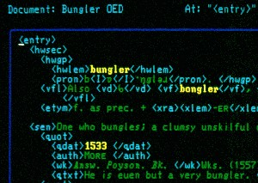
What is Markup Language?
Markup Language(ML) is the widely used document format in tree structure.
  SGML(Standard General Markup Language)
  HTML(Hyper-Text Markup Language)
  XML(Extensible Markup Language)

Slide 4
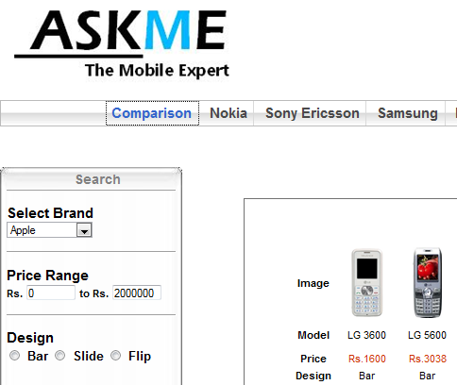
XML versus HTML(SGML)
HTML , SGML is the typeset formats
  Web Documents, Dictionary
Users and Vendors can not define element names freely.
HTML, SGML focused on human readability.

Slide 5
HTML example
<HTML>
<HEAD>
<TITLE>JAPAN</TITLE>
</HEAD>
<BODY>
<H1>Overview</H1>
<P>Japan is …… </P>
</BODY>
</HTML>
HTML
HEADER
BODY
TITLE
H1
P
JAPAN
Overview
Japan is …..

Slide 6
XML versus HTML(SGML)
XML is not only typeset but also interchange formats of objects.
The XML grammar is very strict.
XML focus on ease of processing machinary.
XML standards comprise more than one standard document.

Slide 7
XML
XML standard defines the below 5 types.(others are DTD)
  Element(Tag) ex: <BODY>HTML is…</BODY>
  Attribute ex: <H1 color=“red”></H1>
  Comment ex: <!-- comment -->
  Processor-Instruction ex: <?pi=“test” ?>
  Text(Value) ex: <H1>Overview</H1>
Vendors can define element names, attribute name freely.(except the prefix of “xml” or “XML”)

Slide 8
What is extensible?
Vendors can define elements name freely.
I try to define my Presentation sheet format.
OK, I will write my presentation sheet format.
PPT
Element
Node
TITLE
BODY
VALUE
JAPAN
SHEET
SHEET
width
Japanese overview

Slide 9
XML Example 1
(Presentation Sheet)
<?xml version="1.0" encoding="utf-8" ?>
<PPT>
<TITLE>JAPAN</TITLE>
<BODY>
<SHEET>JAPANESE OVERVIEW</SHEET>
<SHEET width=200> </SHEET>
</BODY>
</PPT>
Well done…

Slide 10
However…
I try to define other Document format.
I don’t know who uses what name as elements.
If I insert the new document data into Presentation sheet…???
PPT
WORD
TITLE
BODY
TITLE
BODY
JAPAN
About
JAPAN
SHEET
SHEET
width
H1
color
P
Japanese overview
Overview
Japan is …..

Slide 11
Conflict of element names
PPT
In processing XML,
we should avoid ambiguous decision.
To avoid the situation, XML introduced a label feature(Namespace)
TITLE
BODY
SHEET
SHEET
WORD
Title
BODY
H1
P

Slide 12
Namespace (1)
PT:PPT
One of extension of XML
This label(prefix) is defined by URL/URI in the document.
URI/URL only provides unique characteristic in the world.
The Namespace standard defines PrefixedAttName
(xmlns:) and DefaultAttName(xmlns).
PT:TITLE
PT:BODY
PT:SHEET
PT:SHEET
WD:WORD
WD:TITLE
WD:BODY
WD:H1
WD:P

Slide 13
XML Example 2
Presentation Sheet has Document
<?xml version="1.0" encoding="utf-8" ?>
<PT:PPT
xmlns:PT="http://tempuri.org/PPT" xmlns:WD="http://tempuri.org/WORD">
<PT:TITLE>JAPAN</PT:TITLE>
<PT:BODY>
<PT:SHEET>JAPANESE OVERVIEW</PT:SHEET>
<PT:SHEET width=200>
<WD:WORD><WD:TITLE>About Japan</WD:TITLE>
<WD:BODY><WD:H1 color=red>Overview</WD:H1>
<WD:P>Japan is ….. </WD:P></WD:BODY>
</WD:WORD>
</PT:SHEET>
</PT:BODY>
</PT:PPT>
PrefixedAttName

Slide 14
What is useful?
XML can provide the strict definition of structure of elements, attributes, and values.
If vendors define their own elements,
  Developers are available to use XML parser on most platforms.
  Each vendor can provide DOM API for handling their XML-based documents.
This is not direct benefit of users. However there are possibility of improving compatibility among vendors.
There are many kinds of XML-based specifications(documents and applications).

Slide 15
XPath (1)
XPath is expression indicating an specific XML element. This is not markup document.
XPath 1.0 is widely used in Web technologies.
  Original XML standard has the below 5 types.
    Element
    Value
    Attribute
    Comment
    Processor-Instruction
  Also, XPath involves Namespace and Root

Slide 16
XPath (2)
Root node represents the top node in XML tree document.
  XML should have an element at least.
  However, XML can not define the element name.
  Root node comes over top level element in XPath.
  Root node can provide the method of distinguishing an absolute path and a relative path.
  What is the absolute path and the relative path?
    XSLT can select a specific element. After XSLT select the specific element, the element’s path become the current path.
    As soon as coming…

Slide 17
XPath example
Absolute path
  "/*" matches all nodes.
  "/PT:PPT" matches <PT:PPT></PT:PPT>
  "/PT:PPT/PT:BODY/PT:SHEET[2]/WD:WORD/WD:BODY/WD:H1@color" matches the attribute of “color=red”.
  "//WD:WORD" matches <WD:WORD></WD:WORD> in the same document.
Relative path
  "PT:SHEET//WD:WORD“ matches <WD:WORD></WD:WORD>, if current path is "/PT:PPT/PT:BODY"
  "WD:H1" matches <WD:H1></WD:H1>, if current path is "/PT:PPT/PT:BODY/PT:SHEET[2]/WD:WORD/WD:BODY“.

Slide 18
XSLT
XSLT is a type of Macro Language.
  Macros are the replacement rules in processing text.
  XSLT is defined by XML and Namespace(xsl)
  Logic element
Element(tag name) | Definition
xsl:stylesheet | top-level element
xsl:template | Specifies processing templates “match” is when the template should be used.
xsl:apply-templates | Specifies that other matches may exist within that node, “select” specify other matching nodes

Slide 19
XML Sample(Last Friday)
<?xml version="1.0" encoding="utf-8" ?>
<?xml-stylesheet type="text/xsl" href="BookDetails.xslt" ?>
<Catalog xmlns="http://www.BookCatalog.com" xmlns:xsi="http://www.w3.org/2001/XMLSchema-instance" xsi:schemaLocation="http://www.BookCatalog.com BookSchema.xsd">
<Book>
<Author>Gambradella, Matthew</Author>
<Title>XML Developer's Guide</Title>
<Genre>Computer</Genre>
<Price>44.95</Price>
<Publish>2000-10-01</Publish>
<Description>qwerty</Description>
</Book>
</Catalog>
Default Namespace

Slide 20
XSLT and XPath (1)
<?xml version="1.0" encoding="utf-8"?>
<xsl:stylesheet version="1.0" xmlns:xsl=“http://www.w3.org/1999/XSL/Transform”
xmlns:bc="http://www.BookCatalog.com">
<xsl:template match="/">
<html>
<head>
<title>example</title>
</head>
<body>
<xsl:value-of select='translate("---------------Bboks----------","bok","ook")' />
<br/>
<xsl:value-of select="concat('AWRD WINNING','BOOK DETAILS')"/>
<xsl:apply-templates select="//bc:Book" />
</body>
</html>
</xsl:template>
Relative path
Absolute path

Slide 21
XSLT and XPath (2)
Relative path
<xsl:template match="bc:Book">
<xsl:if test="contains(bc:Title, 'XML')">
<div>
<b><xsl:value-of select="bc:Title"/></b>
by
<i><xsl:value-of select="bc:Author"/></i>
costs
<xsl:value-of select="bc:Price"/>.
</div>
</xsl:if>
</xsl:template>
</xsl:stylesheet>

Slide 22
Output HTML
<html>
<head><title>example</title></head>
<body>---------------Books----------
<br>AWRD WINNINGBOOK DETAILS<div>
<b>XML Developer's Guide</b> by
<i>Gambradella, Matthew</i> costs 44.95.
</div>
</body>
</html>

Slide 23
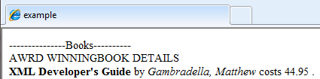
Output

Slide 24
What is benefit?
Vendors can completely separate the document information and look and feels.
If vendors want to change the look and feels, they only change XSLT
Vendors can output the different output format(HTML, ODT, PDF and so on) by creating the different XSLT files.
DocBook is one of the specification based on XSLT/XML/SGML.

Slide 25
THANK YOU FOR YOUR ATTENTION
Q&A

Slide 26
XML Sample 2
<?xml version="1.0" encoding="utf-8" ?>
<?xml-stylesheet type="text/xsl" href="BookDetails.xslt" ?>
<Catalog xmlns="http://www.BookCatalog.com" xmlns:xsi="http://www.w3.org/2001/XMLSchema-instance" xsi:schemaLocation="http://www.BookCatalog.com BookSchema.xsd">
<Book>
<Author>Gambradella, Matthew</Author>
<Title>XML Developer's Guide</Title>
<Genre>Computer</Genre>
<Price>44.95</Price>
<Book>123-456-789</Book>
<Publish>2000-10-01</Publish>
<Description>qwerty</Description>
</Book>
</Catalog>
Default Namespace

Slide 27
XSLT Example 2-1
<?xml version="1.0" encoding="utf-8"?>
<xsl:stylesheet version="1.0" xmlns:xsl=“http://www.w3.org/1999/XSL/Transform”
xmlns:bc="http://www.BookCatalog.com">
<xsl:template match="/">
<html>
<head>
<title>example</title>
</head>
<body>
<xsl:value-of select='translate("---------------Bboks----------","bok","ook")' />
<br/>
<xsl:value-of select="concat('AWRD WINNING','BOOK DETAILS')"/>
<xsl:apply-templates select="//bc:Book" />
</body>
</html>
</xsl:template>
To apply all Book elements

Slide 28
XSLT Example 2-2
Relative path
<xsl:template match="bc:Book">
<div><xsl:value-of select="." />
BookRecord:<xsl:value-of select="bc:Book"/></div> </xsl:template>
</xsl:stylesheet>

Slide 29
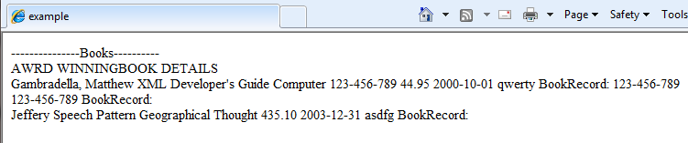
Output HTML2
//bc:Book matches both /bc:Catalog/bc:Book and /bc:Catalog/bc:Book/bc:Book
3 nodes

Slide 30
XSLT Example 3-1
<?xml version="1.0" encoding="utf-8"?>
<xsl:stylesheet version="1.0" xmlns:xsl=“http://www.w3.org/1999/XSL/Transform”
xmlns:bc="http://www.BookCatalog.com">
<xsl:template match="/bc:Catalog">
<html>
<head>
<title>example</title>
</head>
<body>
<xsl:value-of select='translate("---------------Bboks----------","bok","ook")' />
<br/>
<xsl:value-of select="concat('AWRD WINNING','BOOK DETAILS')"/>
<xsl:apply-templates select="bc:Book" />
</body>
</html>
</xsl:template>
To apply only child of Book elements

Slide 31
XSLT Example 3-2
Relative path
<xsl:template match="bc:Book">
<div><xsl:value-of select="." />
BookRecord:<xsl:value-of select="bc:Book"/></div> </xsl:template>
</xsl:stylesheet>

Slide 32
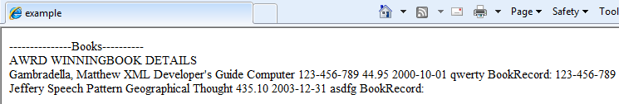
Output HTML3
2 nodes
bc:Book only matches /bc:Catalog/bc:Book

